Slide 1
Linear Algebra
Lecture 6

Slide 2
Systems of
Linear Equations

Slide 3
Matrix
Equations

Slide 4
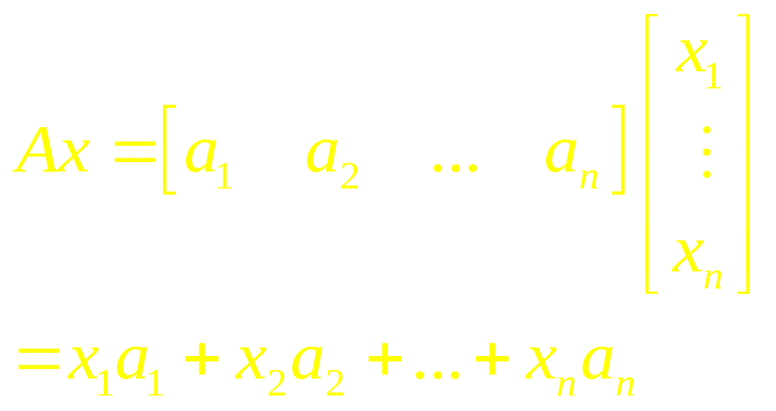
Definition

Slide 5
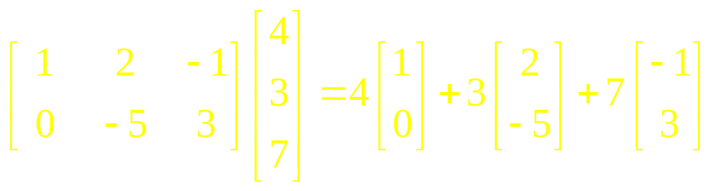
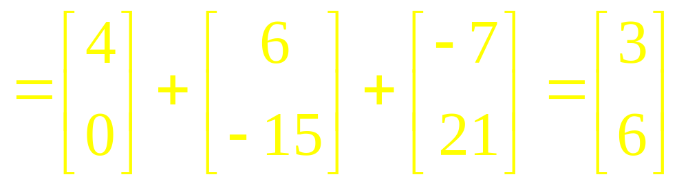
Example 1(a)

Slide 6
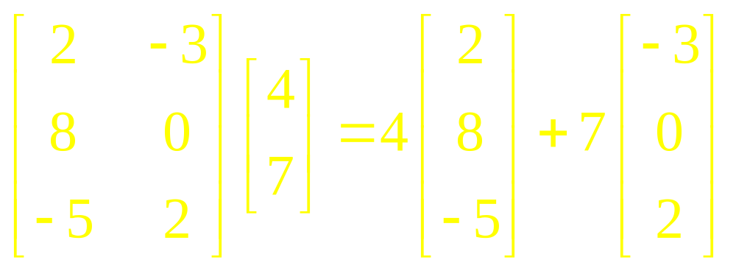
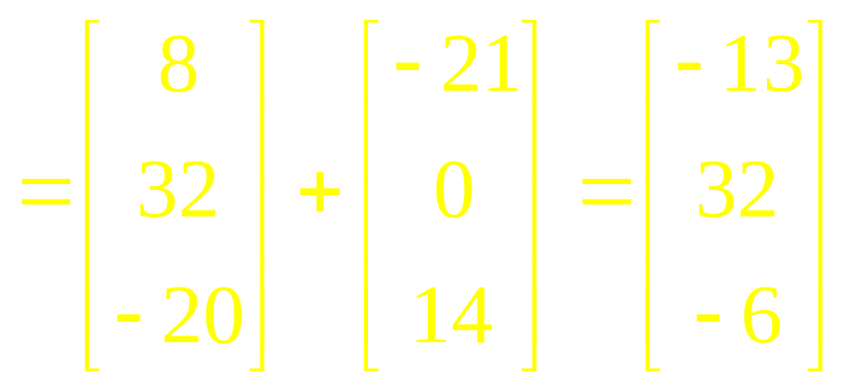
Example 1(b)

Slide 7
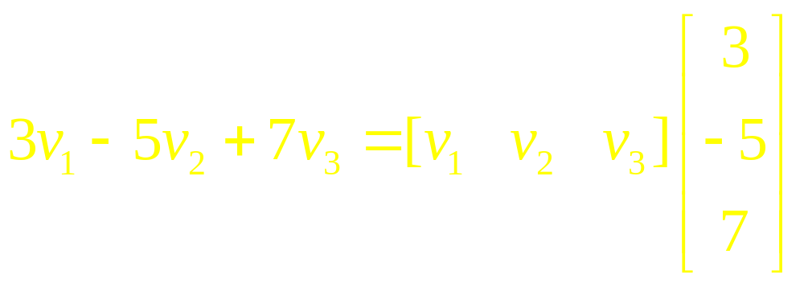

Example 2

Slide 8
Theorem 1

Slide 9
Existence of Solutions
The equation Ax = b has a solution if and only if b is a linear combination of the columns of A.

Slide 10
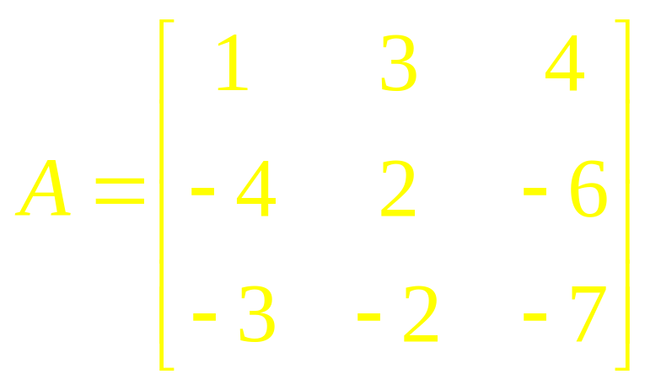
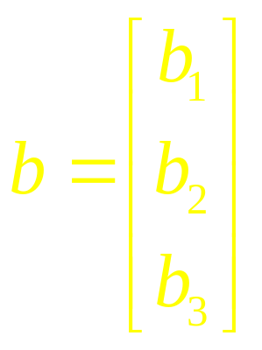
Example 3
Is the equation Ax = b consistent for all possible b₁, b₂, b₃?

Slide 11
Theorem 2
Let A be an mxn matrix. Then the following statements are logically equivalent. That is, for a particular A, either they are all true statements or they are all false.

Slide 12
Theorem 2
For each b in R^{m}, the equation Ax = b has a solution.
The columns of A Span R^{m}.
A has a pivot position in every row.

Slide 13
This theorem is one of the most useful theorems. It is about a coefficient matrix, not an augmented matrix.

Slide 14
If an augmented matrix [A b] has a pivot position in every row, then the equation Ax= b may or may not be consistent

Slide 15
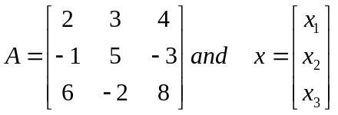
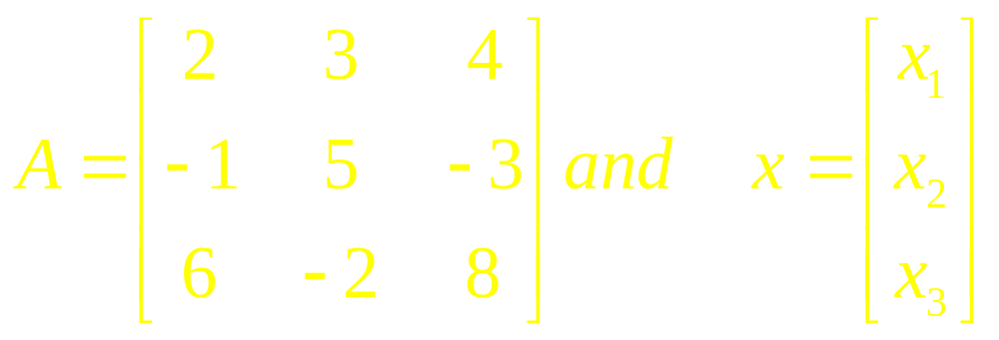
Example 4
Compute Ax

Slide 16
Examples

Slide 17
Linear Algebra
Lecture 6

